Slide 1

A PREDICTIVE FRAMEWORK FOR CYBER SECURITY ANALYTICS USING ATTACK GRAPHS
Alexander Patrick / 1706043292
Michael Ariyanto / 1706043235
Nicholas / 1706043254

Slide 2
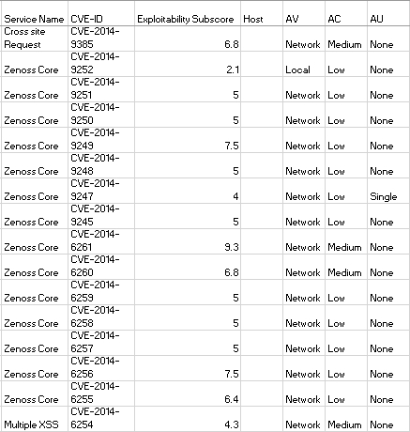
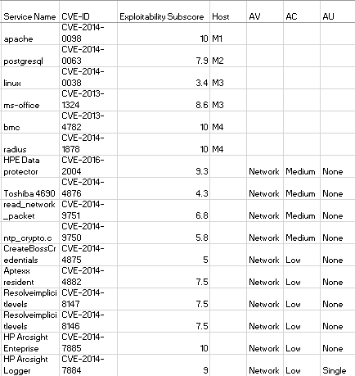
Dataset used

Slide 3
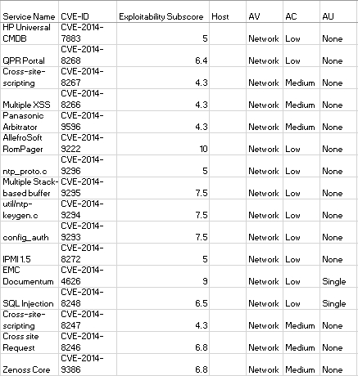

Dataset used
Source of Data:
National Vulnerability Database from the National Institute of Standards and Technology from the U.S Department of Commerce
https://nvd.nist.gov/vuln-metrics/cvss

Slide 4
Stochastic Method
Markov Chain
Why? -> widely used in a variety areas such as system performance analysis and dependability analysis
Behavior of the attacker: he/she will choose the vulnerability that maximizes his or her probability of succeeding in compromising the security goal.
The stochastic model is the third layer of the cyber security analytics architecture
The daily transition-probability matrices are calculated using the well-established Frei's Vulnerability lifecycle model

Slide 5




Model Representation
The exploitability score e for vulnerability v is e(v) and calculated as
The transition matrix
R = absorbing states, Q = transient states
The transition probability of matrix P

Slide 6


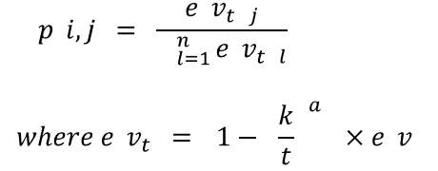
Non-homogenous model
Frei’s model is used to calculate the temporal weight score of vulnerabilities as a part of the attack graph model
The Markov model, the covariate is considered as time dependent

Slide 7

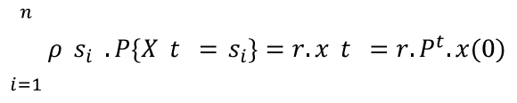
Impact Analysis
The CVSS standard provides a framework for computing the impact associated with an individual vulnerability (v) using confidentiality impact (c), integrity impact (I) and availability impact (A) measures as follows
Given our existing DTMC model, we can represent the Markov Reward process as where S,P is a DMTC and ρ is a reward function for each state.

Slide 8
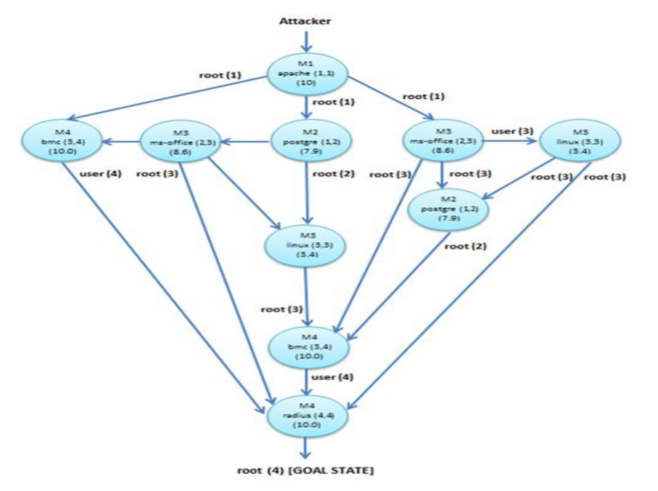
Result
Berdasarkan data yang didapatkan dibuatlah sebuah topologi yang mengikuti Absorbing Markov Chain untuk mencari state mana yang paling vulnerable dan harus dilakukan patch

Slide 9
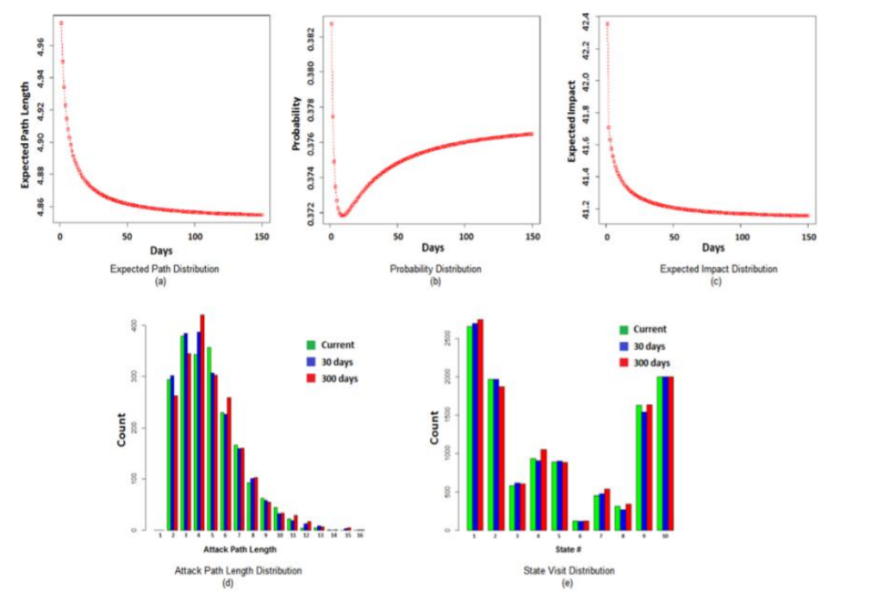
Result
Berdasarkan hasil simulasi yang dilakukan 2000 kali, didapatkan bahwa service bmc pada M4 yang merupakan titik paling sering diexploit dan service linux pada M3 merupakan titik yang paling sedikit diexploit

